Slide 1

Data Structures and Algorithms (CS-2001)
KALINGA INSTITUTE OF INDUSTRIAL TECHNOLOGY
School of Computer Engineering
Strictly for internal circulation (within KIIT) and reference only. Not for outside circulation without permission
4 Credit
Lecture Note

Slide 2
Chapter Contents
Sr # | Major and Detailed Coverage Area | Hrs
5 | Trees | 8
 | Introduction, Binary Trees, Binary Tree Traversals, Threaded Binary Trees, Binary Search Trees, AVL Trees

Slide 3
Introduction
There are many basic data structures that can be used to solve application problems. Array is a good data structure that can be accessed randomly and is fairly easy to implement. Linked Lists on the other hand is dynamic and is ideal for application that requires frequent operations such as add, delete, and update. One drawback of linked list is that data access is sequential. Then there are other specialized data structures like, stacks and queues that allows to solve complicated problems using these restricted data structures.
One of the disadvantages of using an array or linked list to store data is the time necessary to search for an item. Since both the arrays and Linked Lists are linear structures the time required to search a “linear” list is proportional to the size of the data set. For example, if the size of the data set is n, then the number of comparisons needed to find (or not find) an item may be as bad as n. So imagine doing the search on a linked list (or array) with n = 106 nodes. Even on a machine that can do million comparisons per second, searching for m items will take roughly m seconds. This not acceptable in today’s world where speed at which we complete operations is extremely important. Time is money. Therefore it seems that better (more efficient) data structures are needed to store and search data.
In this chapter, we can extend the concept of linked data structure (linked list, stack, queue) to a structure that may have multiple relations among its nodes. Such a structure is called a tree. A tree is a nonlinear data structure, compared to arrays, linked lists, stacks and queues which are linear data structures.

Slide 4
To Become Rich
Become Rich
Unethical Ways
Ethical Ways
Force others to be Poor
Rob
Banks
Stock
Fraud
Invest
Avoid Depreciated Value Purchase
Save Money
Real Estate
Stock Market
Your Time
Retirement

Slide 5

Nature View of a Tree
leaves
branches
root

Slide 6
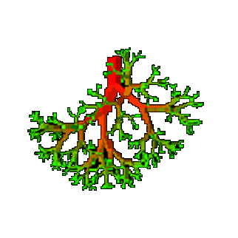
Computer View
root
leaves
branches
nodes

Slide 7
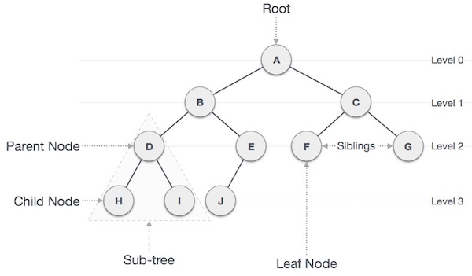
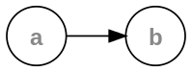

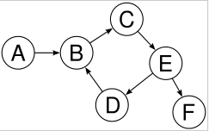
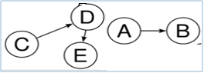
What is a Tree?
A tree is a finite nonempty set of nodes and edges without having any cycle.
It is an abstract model of a hierarchical structure.
Nodes represents the parent-child relation.
Which of the following are tree?

Slide 8
Tree Terminology
Path − Refers to sequence of nodes along the edges of a tree.
Root Node − Node at the top of the tree is called root. There is only one root per tree and one path from root node to any node. So node without parent is also called root.
Parent Node − Any node except root node has one edge upward to a node.
Child Node − Node below a given node connected by its edge downward.
Leaf Node - Node which does not have any child node.
Internal Node – Node with at least one child
Subtree − Subtree represents descendents of a node.
Visiting − Refers to checking value of a node when control is on the node.
Traversing − Passing through nodes in a specific order.
Levels − Level of a node represents the generation of a node. If root node is at level 0, then its next child node is at level 1, its grandchild is at level 2 and so on.
Keys − Key represents a value of a node based on which a search operation is to be carried out for a node.
Degree – The degree of a node is the number of its children & the degree of a tree is the maximum degree of any of its node.
Siblings – nodes share the same parent
A
B
C
D
Subtree
E
F
G
H
I
J
K
Ancestors of a node: parent, grandparent, grand-grandparent, etc.
Descendant of a node: child, grandchild, grand-grandchild, etc.
Depth of a node: number of ancestors. Depth of tree is 1 more than the maximum depths of the depths of the left and right subtrees of tree
Height of a tree: maximum depth of any node

Slide 9

Class Work
A
Sr # Property Value
1 Number of nodes of the tree
2 Height of the tree
3 Root Node of the tree
4 Leaves of the tree
5 Interior nodes of the tree
6 Ancestors of H node
7 Descendants of B node
8 Siblings of E node
9 Right subtree of A node
10 Degree of the tree
11 Parent node of D
12 Child nodes of G
13 Level of node G
B
C
D
E
F
G
H
I

Slide 10
Intuitive Representation
Every tree node:
INFO – useful information
Child – pointers to its children
Data
Data
Φ
Φ
Φ
Data
Φ
Data
Φ
Φ
Data
Φ
Φ
Φ
Data
Φ
Φ
Φ
Data
Φ
Φ
Φ

Slide 11
Trees Application
Tree is a fundamentally hierarchical structure. Thus, a tree is appropriate to model any reality that exhibits hierarchy:
File system directories.
Genealogical trees of all sorts: family relationships among individuals, tribes, languages etc.
Classifications systems:
Taxonomic classification of plants and animals.
Dewey decimal (or Library of Congress) classification of books.
Breakdown of a manufactured product into subassemblies, each of turn consists of sub-subassemblies etc. down to the smallest components.
Structure of a program - main routine is the root, procedures it contains are subtrees, each of which contains nested procedure definitions etc.
Information storage and retrieval situations such as symbol tables, even though hierarchy may not be involved.
Expression Tress – Compilers and Interpreters as well in symbolic mathematics program to represent arithmetic expressions.
Game Tree – Game playing

Slide 12
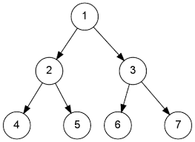
Binary Trees
A binary tree T is defined as a finite set of elements called node such that :
T is empty (called the empty tree or null tree) or
T contains a distinguished node R, called the root node of T and the remaining nodes of T form an ordered pair of disjoint binary trees T1 and T2.
So - a binary tree is a tree data structure in which each node has at most two children (i.e. either 0 or 1 or 2), which are referred to as the left child and the right child.
If T contains a root R, then the two trees T1 and T2 are called the left and right subtree of R. If T1 is non empty then its root is called the left successor of R. Similarly if T2 is not empty then its root is called the right successor of R.
T1
T2

Slide 13
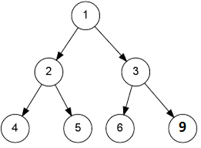
Similar Trees and Tree Copies
Similar Trees
Tree Copies
Binary trees are said to be similar if they have the same structure or in other words, if they have the same shape.
The trees are said to be copies if they are similar and if they have same contents at corresponding nodes

Slide 14
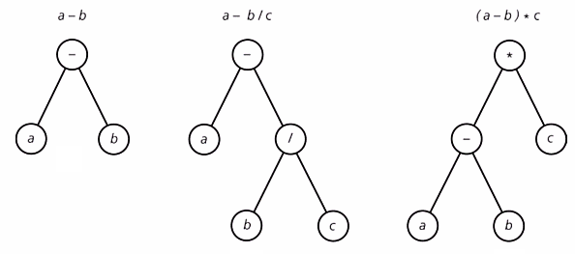
Binary Expression Trees
A binary expression tree is a specific kind of a binary tree used to represent expressions. Each node of a binary tree, and hence of a binary expression tree, has zero, one, or two children. This restricted structure simplifies the processing of expression trees. The leaves of a binary expression tree are operands, such as constants or variable names, and the other nodes contain operators i.e. each internal node corresponds to operator and each leaf node corresponds to operand.

Slide 15
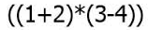
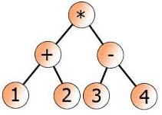
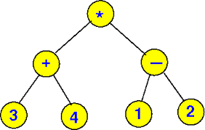
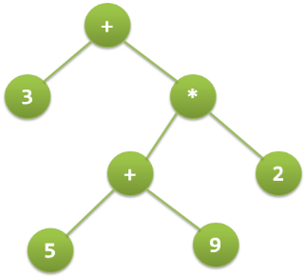
Algebraic Expressions Representation
((3+4)*(1-2))
3 + ((5+9)*2)

Slide 16
Expression Tree Class Work
Draw the expression tree corresponding to the following:
E = (a/(b + d)) + ((a² – d²)/2)
F = ((X +Y)^2) – ((X-4)/12)
A = 10/4 + 2*(5+1)
X = ((5*A+B)*(3*C+D))^3
Y = (35 - 3*(3+2)) / 4

Slide 17

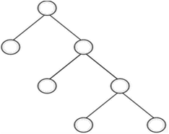
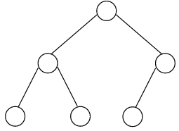


Full and Complete Binary Trees
Full Binary Tree
Complete Binary Tree
A binary tree T if each node is either a leaf or possesses exactly two child nodes.
A binary tree T with n levels is complete if all levels except possibly the last are completely full, and the last level has all its nodes to the left side.
Class Work
Full but not Complete
Complete but not Full
Full and Complete
Neither Full nor Complete

Slide 18
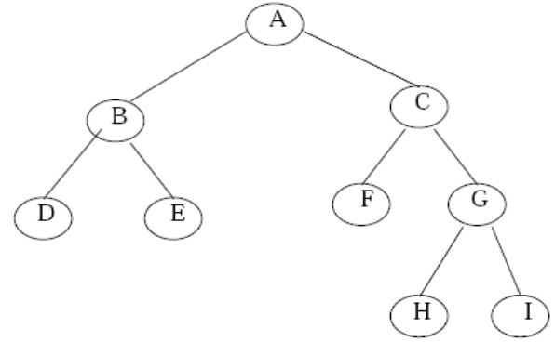
Extended Binary Trees : 2-Trees
The tree is said to be strictly or extended or 2-trees binary tree, if every non-leaf made in a binary tree has non-empty left and right sub trees. A strictly binary tree with n leaves always contains 2*n–1 nodes.

Slide 19
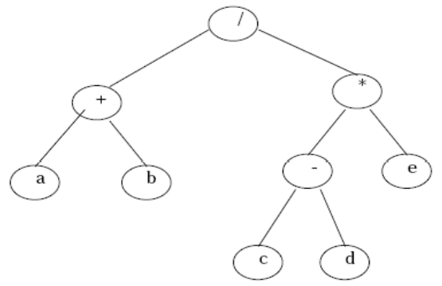
Extended Binary Trees cont…
The main application of a 2-tree is to represent and compute any algebraic expression using binary operation. For example, consider an algebraic expression E, where E = (a +b ) / ((c – d) * e)

Slide 20
Representing Binary Trees in Memory
Let T be the binary tree. There are 2 ways of representing binary tree in memory. The first and usual way is called the link representation of T and the second way which uses a single array called the sequential representation of T.
Sequential Representation
Binary Trees can be represented using 1-D array in memory. The rule to store binary tree in array are :
The values of binary tree is stored in an array called as tree.
The root of the tree is stored at first location i.e. at tree[0](or at 0th index).
The left child of tree is stored at 2i +1 and right child is stored at 2i+2 location.
The maximum size of the array tree is given as 2^{h+1}-1, where h is the height of the tree.
An empty tree or sub-tree is specified using NULL. If tree[0] = NULL, then it means that tree is empty.

Slide 21
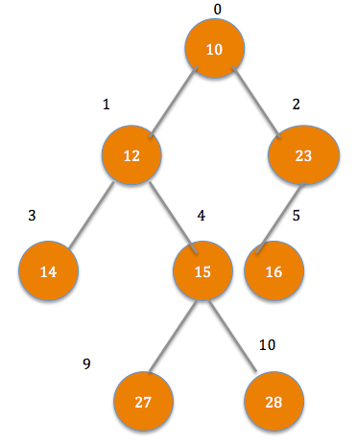
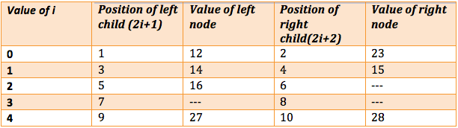
Sequential Representation of Binary Tree
tree
Position of left and right child

Slide 22
Linked Representation of Binary Tree
Approach 1 - Parallel Array
Consider a binary tree T. The linked representation uses three parallel arrays i.e. INFO,LEFT & RIGHT & a pointer variable ROOT. Each node N of T will correspond to a location K such that:
INFO[K] contains the data at node N.
LEFT[K] contains the location of left child of node N.
RIGHT[K] contains the location of right child of node N.
ROOT will contain location of root R of T.
If any subtree is empty, then the corresponding pointer will contain NULL values; if the tree T itself is empty, then ROOT will contain NULL

Slide 23
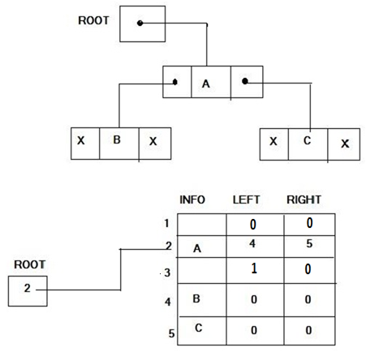
Linked Representation – Parallel Arrays

Slide 24
Linked Representation of Binary Tree
Approach 2 - Nodes
Binary trees can be represented by links where each node contains the address of the left child and the right child. If any node has its left or right child empty then it will have in its respective link field, a null value. A leaf node has null value in both of its links.
The structure defining a node of binary tree in C is as follows.
struct node
{
struct node *leftChild ; /* points to the left child */
int data; /* data field */
struct node *rightChild; /* points to the right child */
}

Slide 25

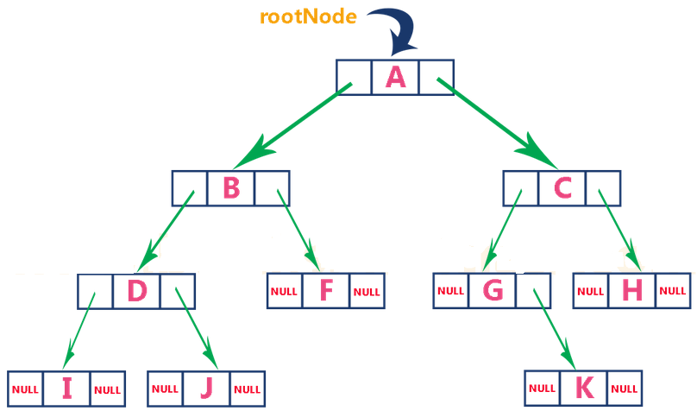
Linked Representation – Nodes
Node Structure
Illustration

Slide 26
Binary Tree Node Structure & Basic Operation
A tree node should look like the below structure. It has data part and references to its left and right child nodes.
struct node
{
struct node *leftChild;
int data;
struct node *rightChild;
} *root;
Basic operations that can be performed on binary search tree data structure, are −
Insert − insert a node in a tree / create a tree.
Search − search an element in a tree.
Delete – Delete the tree or delete a node in the tree.
Preorder Traversal − traverse a tree in a preorder manner.
Inorder Traversal − traverse a tree in an inorder manner.
Postorder Traversal − traverse a tree in a postorder manner.

Slide 27
Binary Tree Traversal
Traversal is a process to visit all the nodes of a tree and may print their values too. Because, all nodes are connected via edges, traverse always start from the root node and one cannot random access a node in tree. There are three ways to traverse a tree −
In-order Traversal
Pre-order Traversal
Post-order Traversal

Slide 28
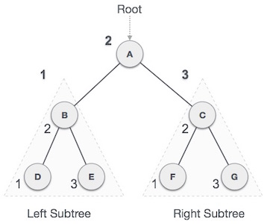
In-order Traversal
In this traversal method, the left-subtree is visited first, then root and then the right sub-tree.
Recursive Algorithm
Step 1 − Start
Step 2 − Repeat steps 3, 4 and 5 until all nodes are traversed
Step 3 − Recursively traverse left subtree
Step 4 − Visit root node
Step 5 − Recursively traverse right subtree
Step 6 − Stop
Output
Traversal start from A, and following in-order traversal, we move to its left subtree B. B is also traversed in-ordered and the process goes on until all the nodes are visited. The output of in-order traversal of this tree is
D → B → E → A → F → C → G

Slide 29
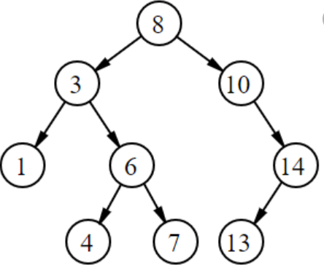
Algorithm (Inorder Traversal)
Inorder: 1 3 4 6 7 8 10 13 14

Slide 30
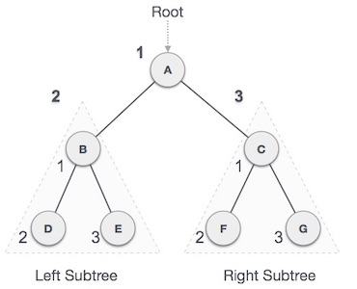
Pre-order Traversal
In this traversal method, the root node is visited first, then left subtree and finally right sub-tree.
Recursive Algorithm
Step 1 − Start
Step 2 − Repeat steps 3, 4 and 5 until all nodes are traversed
Step 3 − Visit root node
Step 4 − Recursively traverse left subtree
Step 5 − Recursively traverse right subtree
Step 6 − Stop
Output
Traversal start from A, and following pre-order traversal, we first visit A itself and then move to its left subtree B. B is also traversed pre-ordered. And the process goes on until all the nodes are visited. The output of pre-order traversal of this tree is A → B → D → E → C → F → G

Slide 31
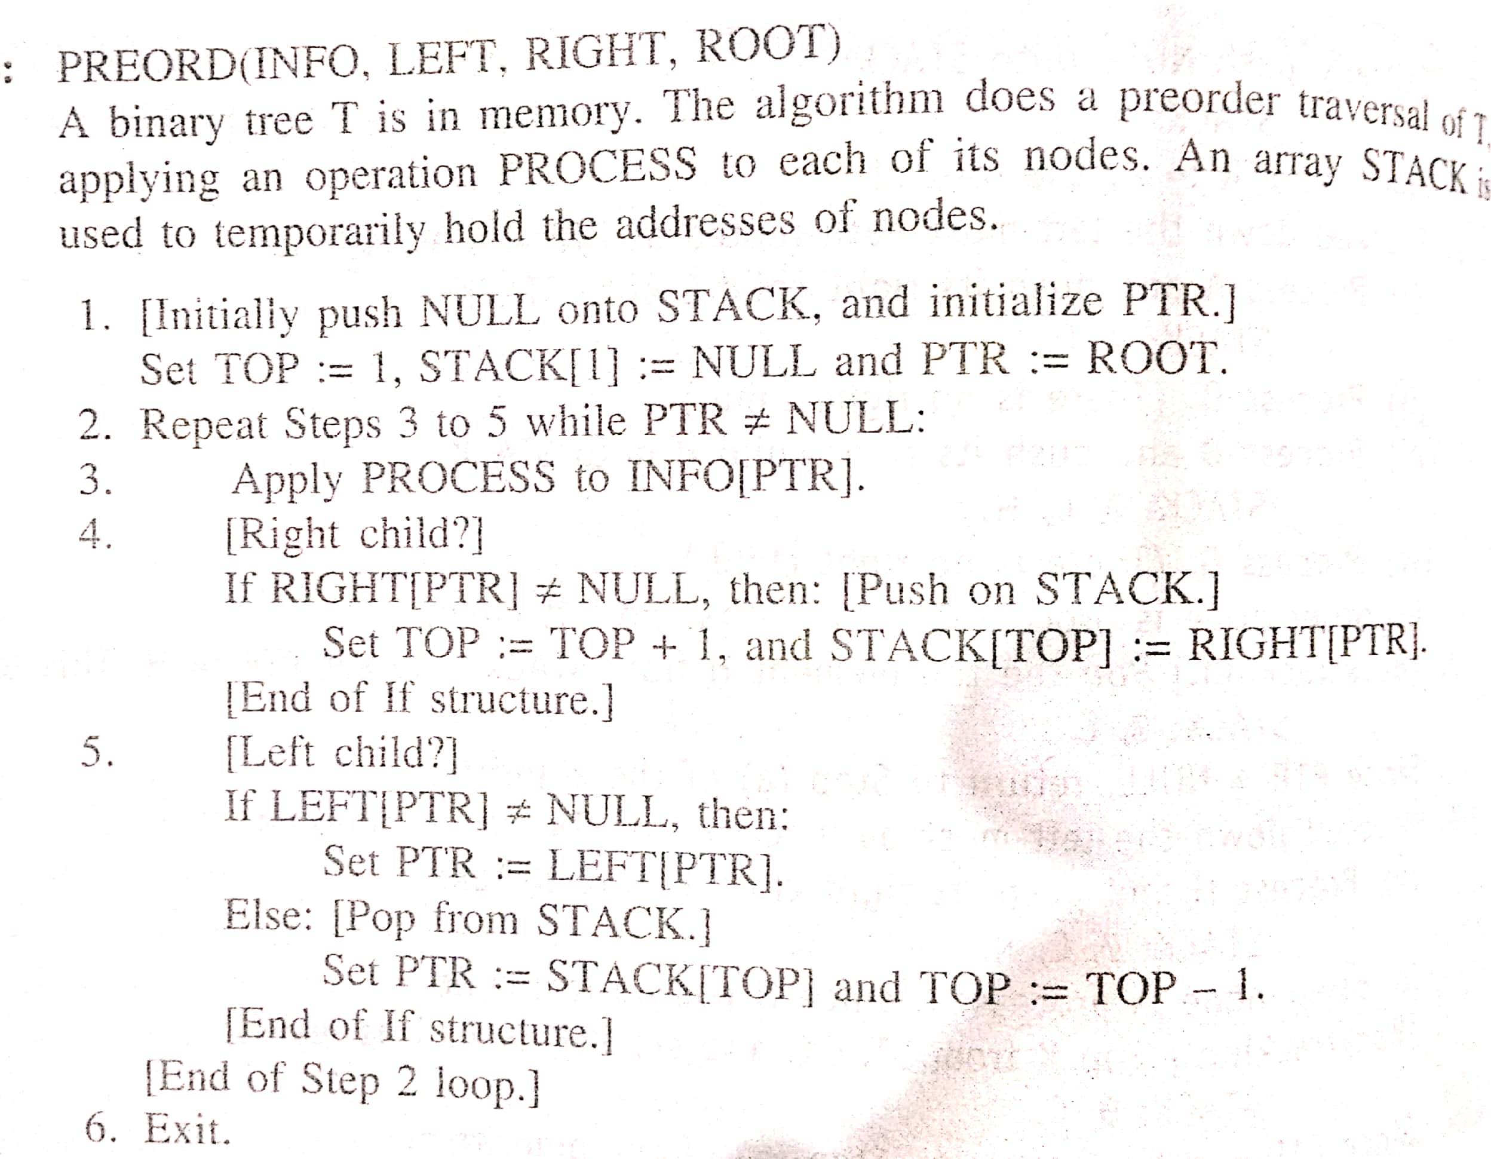
Algorithm (Preorder Traversal)
Preorder: 8 3 1 6 4 7 10 14 13

Slide 32
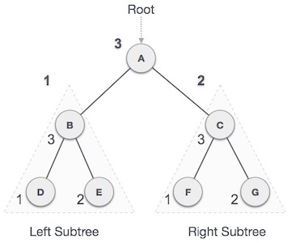
Post-order Traversal
In this traversal method, the root node is visited last, hence the name. First the left subtree is traversed, then right subtree and finally root.
Recursive Algorithm
Step 1 − Start
Step 2 − Repeat steps 3, 4 and 5 until all nodes are traversed
Step 3 − Recursively traverse left subtree
Step 4 − Recursively traverse right subtree
Step 5 − Visit root node
Step 6 − Stop
Output
Traversal start from A, and following pre-order traversal, we first visit left subtree B. B is also traversed post-ordered. And the process goes on until all the nodes are visited. The output of post-order traversal of this tree is D → E → B → F → G → C → A

Slide 33
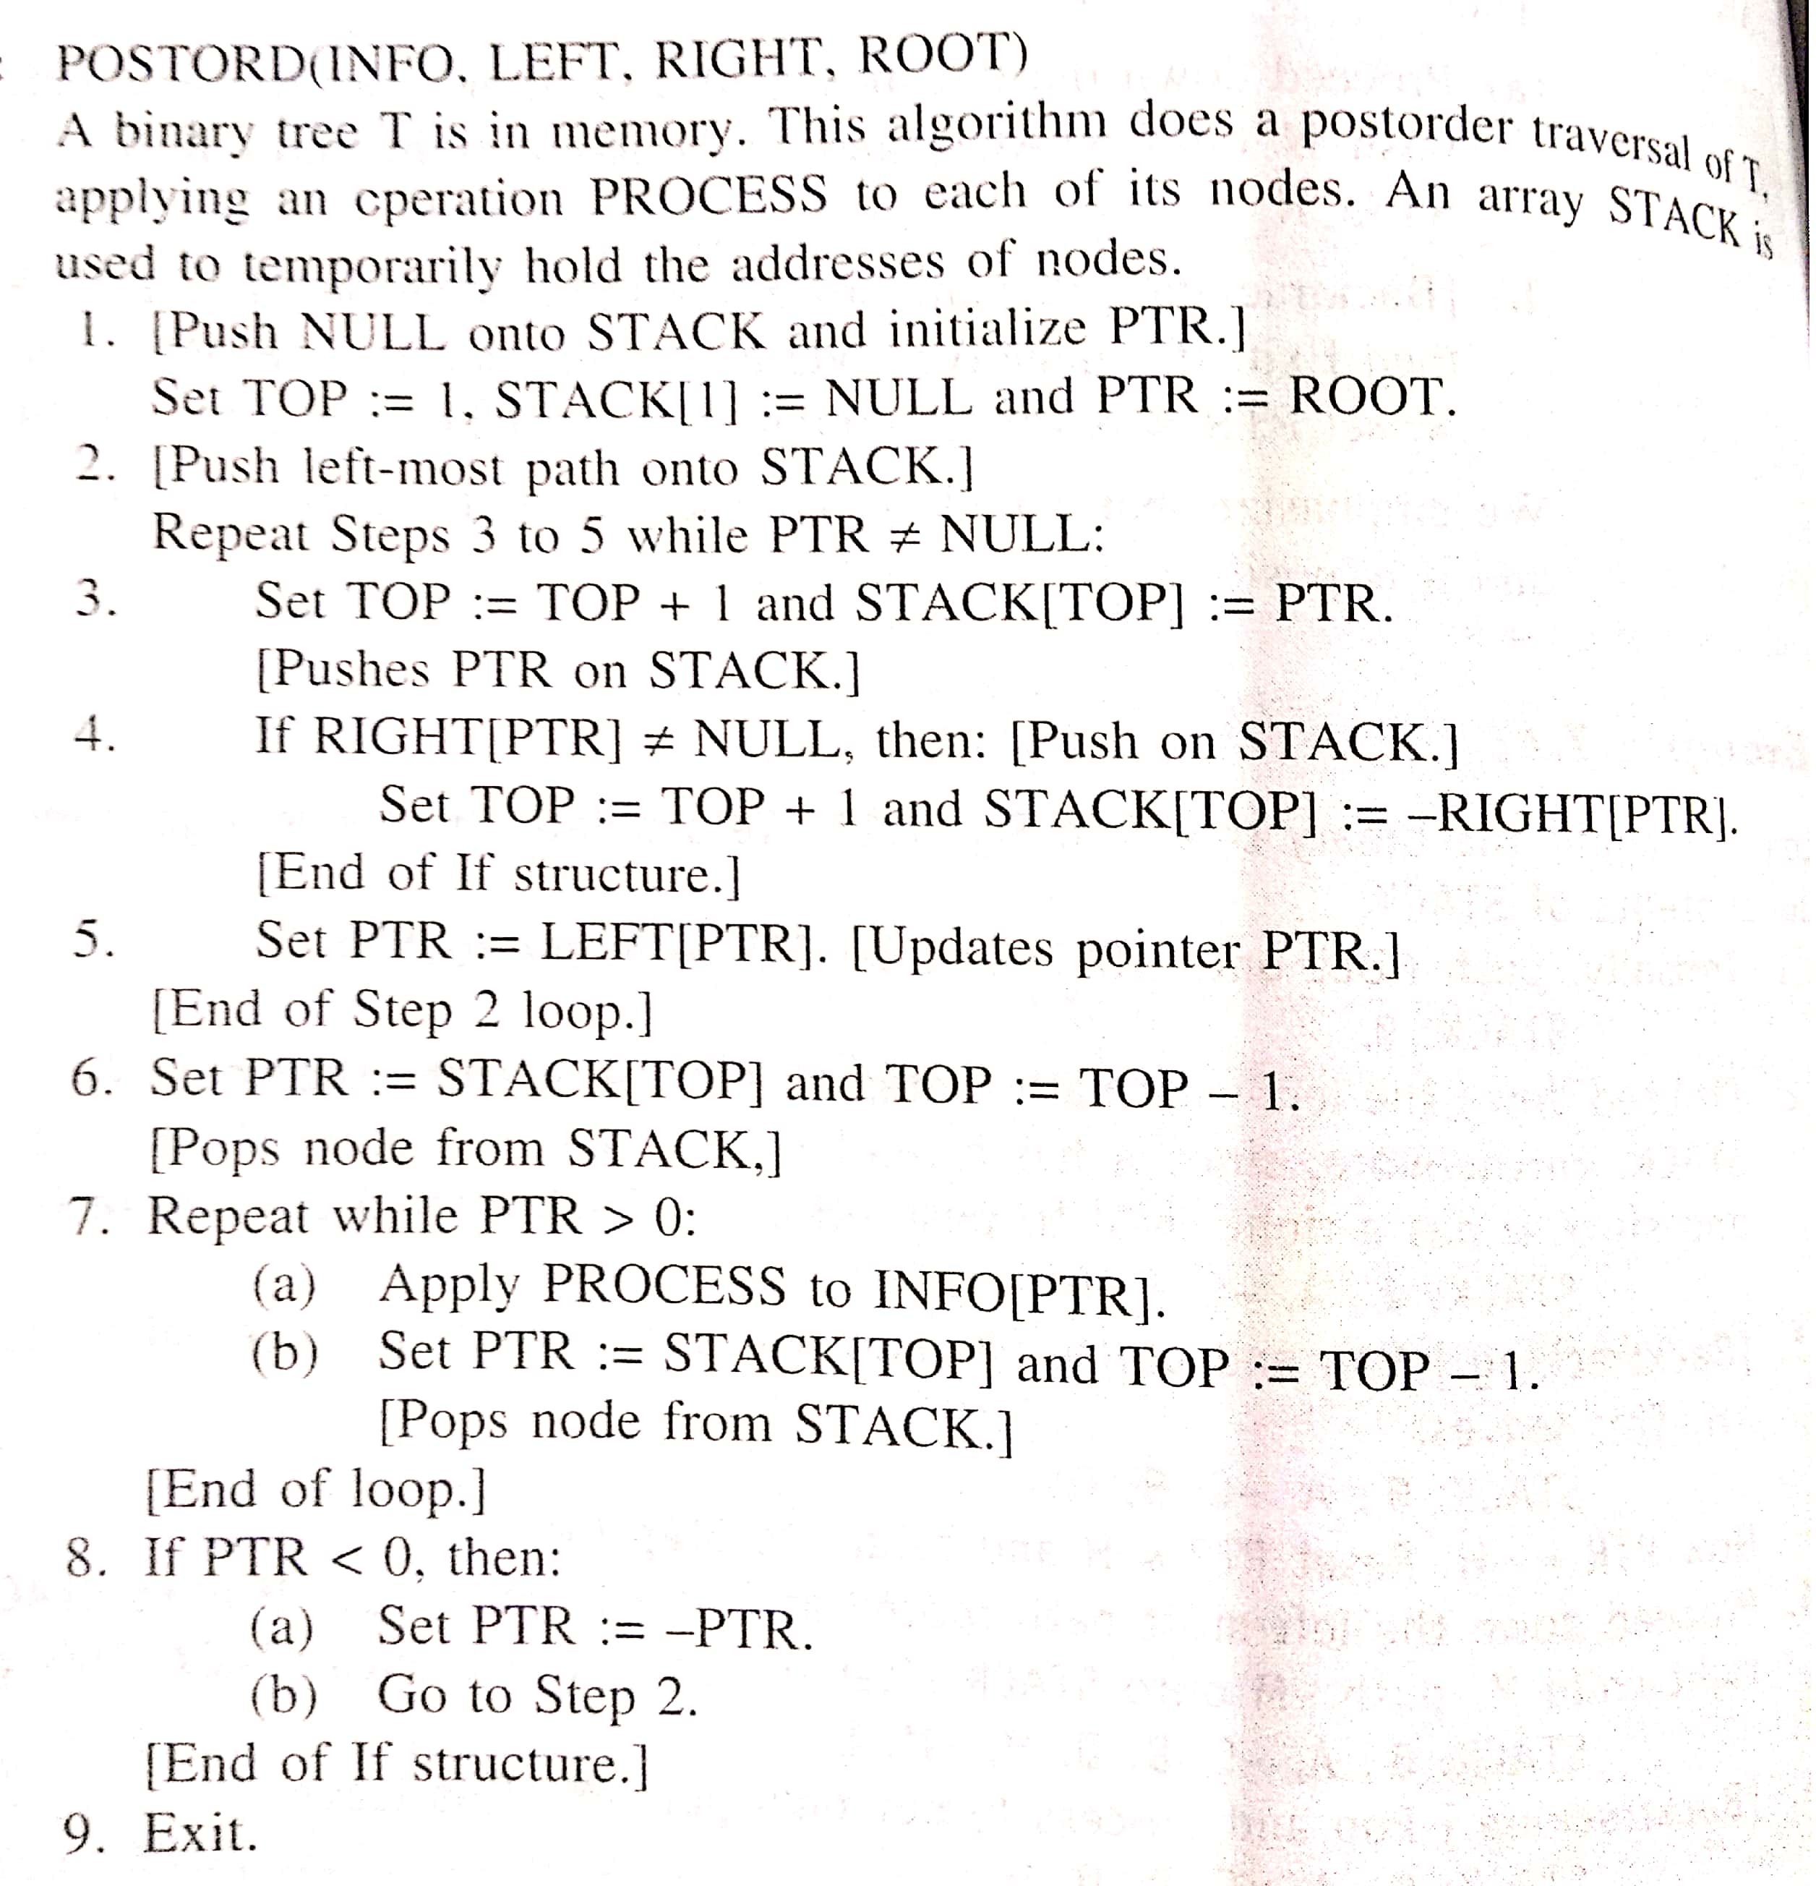
Algorithm (Postorder Traversal)
Postorder: 1 4 7 6 3 13 14 10 8

Slide 34
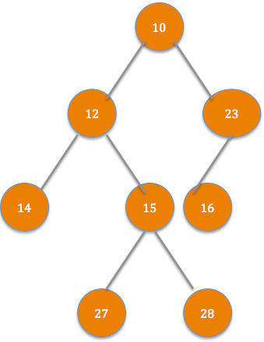
Level-order Traversal
In this traversal method, visit the nodes level by level from left to right
Recursive Algorithm
Step 1 − Start
Step 2 − Visit the root node (Level 0)
Step 3 − Visit the root’s left child followed by right child (Level 1)
Step 4 − Recursively visit the next levels from left most child to right most child (Level 2 and onwards) until all levels are covered
Step 5 − Stop
Output
10 → 12 → 23 → 14 → 15 → 16 → 27 → 28

Slide 35
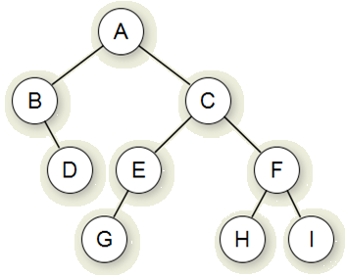
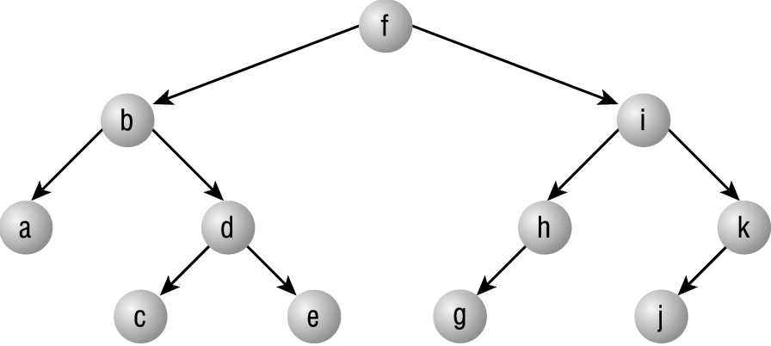
Class Work
What are the In Order, Pre Order and Post Order traversal sequence of following trees?
In Order : B → D → A → G → E → C → H → F → I
Pre Order : A → B → D → C → E → G → F → H → I
Post Order : D → B → G → E → H → I → F → C → A
In Order : a → b → c → d → e → f → g → h → i → j → k
Pre Order : f → b → a → d → c → e → i → h → g → k → j
Post Order : a → c → e → d → b → g → h → j → k → i → f
Note
In Order : LPR
Pre Order : PLR
Post Order : LRP
P: Parent, L: Left and R: Right

Slide 36
Class Work – Construction of Binary Tree
In Order : B → D → A → G → E → C → H → F → I
Is the tree different? If so – don’t worry
With one sequence, it is not possible to estimate the left/right child of the tree. So a given In-Order sequence, will not generate exact binary tree. Similarly given Pre-Order or Post-order sequence will not generate exact binary tree. So to generate the exact binary tree, more than 2 traversal sequence is mandate.
If you are given two traversal sequences, can you construct the binary tree?
It depends on what traversals are given. If one of the traversal methods is In-order then the tree can be constructed, otherwise not. Therefore, following combination can uniquely identify a tree.
In-order and Pre-order
In-order and Post-order

Slide 37
Construction of Binary Tree from In Order and Pre Order Traversal
In Order : LPR and Pre Order : PLR
In Order : B → D → A → G → E → C → H → F → I
Pre Order : A → B → D → C → E → G → F → H → I
Steps to be followed
First element in the Pre Order is the root of the tree, hence it is A
Now search element A in “In Order”, say you find it at position i, once you find it, make note of elements which are left to i (this will construct the left subtree) and elements which are right to i ( this will construct the right subtree).
Recursively construct left subtree and link it root left and recursively con­struct right subtree and link it root right.
P: Parent, L: Left and R: Right

Slide 38
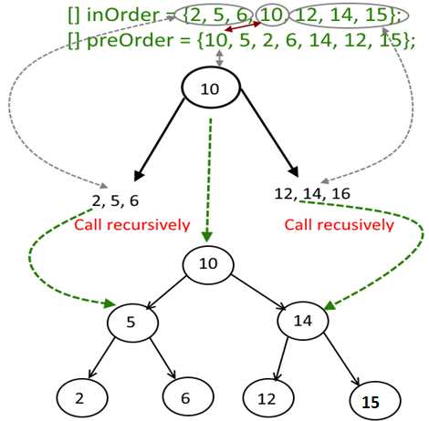
Construction of Binary Tree from In Order and Pre Order Traversal
In Order : {2,5,6,10,12,14,15} and Pre Order : {10,5,2,6,14,12,15}

Slide 39
Construction of Binary Tree from In Order and Post Order Traversal
In Order : LPR and Post Order : LRP
In Order : B → D → A → G → E → C → H → F → I
Post Order : D → B → G → E → H → I → F → C → A
Steps to be followed
Last element in the Post Order is the root of the tree, hence it is A
Now search element A in “In Order”, say you find it at position i, once you find it, make note of elements which are left to i (this will construct the left subtree) and elements which are right to i ( this will construct the right subtree).
Recursively construct left subtree and link it root left and recursively con­struct right subtree and link it root right.
P: Parent, L: Left and R: Right

Slide 40
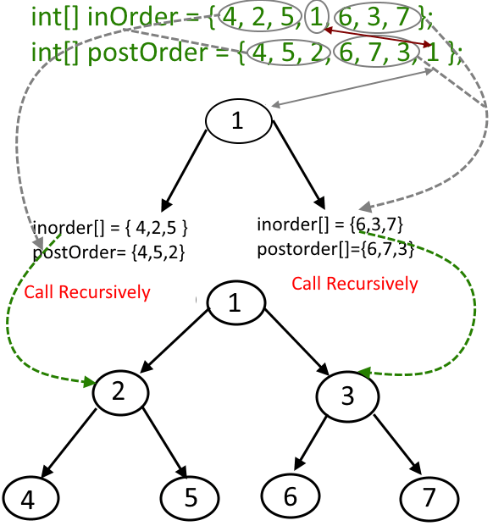
Construction of Binary Tree from In Order and Post Order Traversal
In Order : {4, 2, 5, 1, 6, 3, 7} and Post Order : {4, 5, 2, 6, 7, 3, 1}

Slide 41
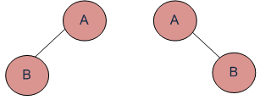
Construction of Binary Tree from Pre Order and Post Order Traversal
Pre Order : PLR and Post Order : LRP
Pre Order : A → B
Post Order : B → A
Conclusion
One cannot create an exact binary tree from preorder and postorder only as you would never be able to estimate the left/right child of the tree.
You need the inorder traversal along with the any of the above
P: Parent, L: Left and R: Right

Slide 42
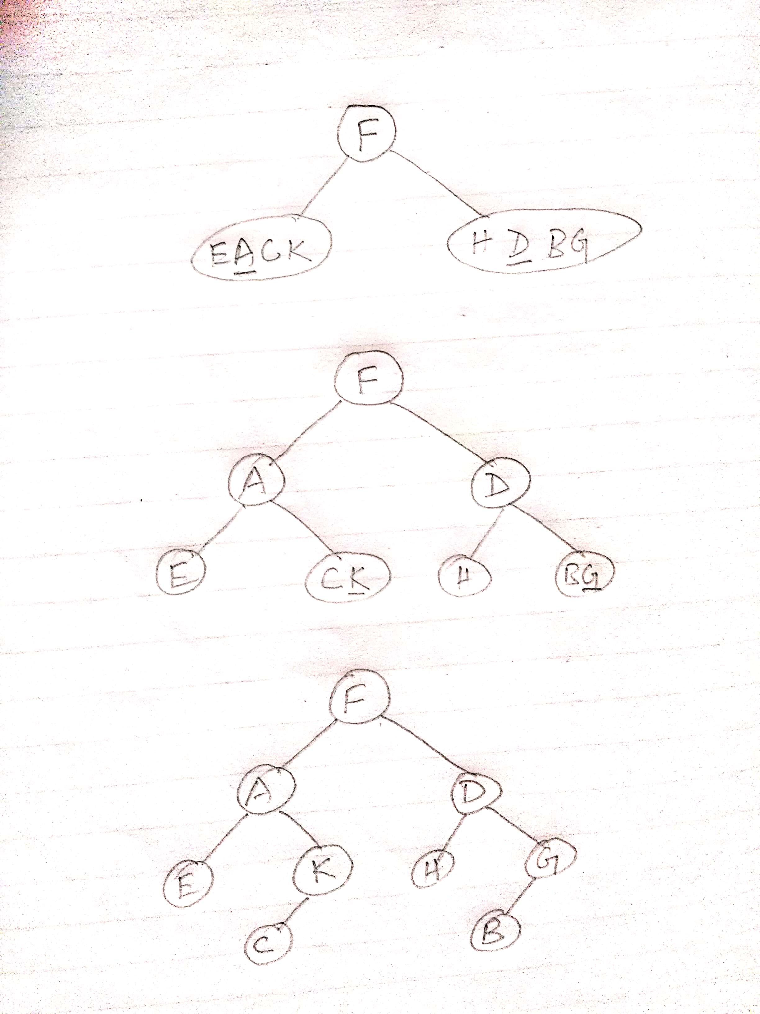
Excercise
Create the binary tree from:
Inorder: E A C K F H D B G
Preorder:F A E K C D H G B

Slide 43
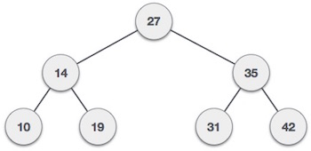
Binary Search Tree
A binary search tree (BST) is a tree in which all nodes follows the below mentioned properties −
The left sub-tree of a node has data less than to its parent node's data.
The right sub-tree of a node has data greater than to its parent node's data.
Thus, a BST divides all its sub-trees into two segments; left sub-tree and right sub-tree and can be defined as - left_subtree (data) < node (data) < right_subtree (data)
Example
Quick Questions?
Question - Where is the smallest & largest element in binary search tree resides?
Answer - Leftmost & Rightmost Positions

Slide 44
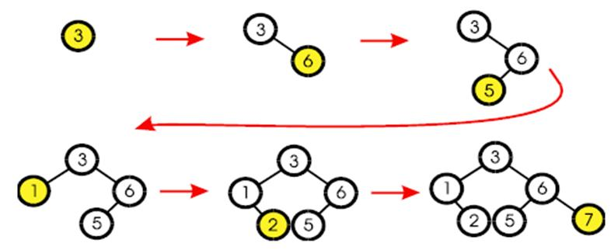
BST- Insertion

Slide 45
BST- Insertion Algorithm
if tree is empty
create a root node with the new key
else
compare key with the top node
if key = node key
replace the node with the new value
else if key > node key
compare key with the right subtree:
if subtree is empty create a leaf node
else add key in right subtree
else key < node key
compare key with the left subtree:
if the subtree is empty create a leaf node
else add key to the left subtree

Slide 46
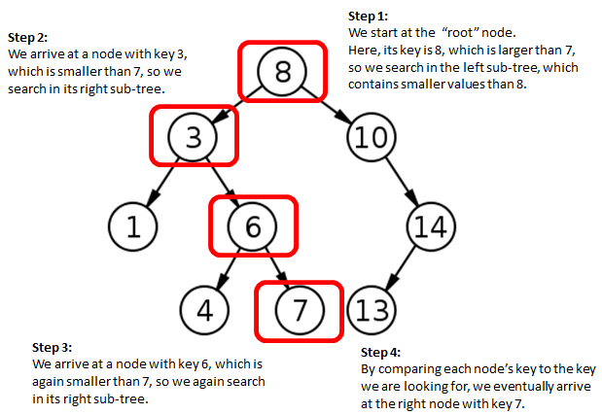
BST- Search
Node with key value 7 to be searched

Slide 47
BST– Search Algorithm
if the tree is empty
return NULL
else if the key value in the node(root) equals the target
return the node value
else if the key value in the node is greater than the target
return the result of searching the left subtree
else if the key value in the node is smaller than the target
return the result of searching the right subtree

Slide 48
BST– Search - C Function
/* return a pointer to the node that contains key. If there is no such node, return NULL */
node* search(node * root, int key)
{
if (!root)
{
return NULL;
}
if (key == root->key)
{
return root;
}
if (key < root->key)
{
return search(root->left, key);
}
return search(root->right, key);
}

Slide 49
BST – Search Minimum and Maximum Key C Function
Minimum Key
Maximum Key
node* searchMinimum(node * root)
{
if (!root)
{
return NULL;
}
while (root -> left != NULL)
{
root = root -> left;
}
return root;
}
node* searchMaximum(node * root)
{
if (!root)
{
return NULL;
}
while (root -> right != NULL)
{
root = root -> right;
}
return root;
}

Slide 50
BST - Deletion
Removing a node from a BST is a bit more complex, since any “holes” should not be created in the tree. The intention is to remove the specified item from the BST and adjusts the tree.
The binary search algorithm is used to locate the target item: starting at the root, it probes down the tree till it finds the target or reaches a leaf node.
Experimenting the cases
if the tree is empty return false
else attempt to locate the node containing the target using the binary search algorithm:
if the target is not found return false
else the target is found, then remove its node & return true. Now while removing the node four cases may happen
Case 1 - if the node has 2 empty subtrees
Case 2 - if the node has a left and a right subtree
Case 3 - if the node has no left child
Case 4 - if the node has no right child

Slide 51
BST – Deletion – Case 1
Case 1: removing a node with 2 empty subtrees
Action: replace the link in the parent with null and delete the node
Removing 4
Parent
7
7
5
9
5
9
Z
4
6
8
10
6
8
10
Z points to the node which is to be deleted from the tree

Slide 52
BST – Deletion – Case 2
Case 2: removing a node with 2 subtrees
Action: - replace the node's value with the max value in the left subtree and delete the max node in the left subtree
Removing 7
Z
7
6
5
9
5
9
4
6
8
10
4
8
10
Z points to the node which is to be deleted from the tree

Slide 53
BST – Deletion – Case 3
Case 3: if the node has no left child
Action: link the parent of the node to the right node of non-empty subtree and delete the node
Removing 5
Parent
Parent
Z
7
7
5
9
9
6
6
8
10
8
10
Z points to the node which is to be deleted from the tree

Slide 54
BST – Deletion – Case 4
Case 4: if the node has no right child
Action: link the parent of the node to the left node of non-empty subtree and delete the node
Removing 5
Parent
Parent
Z
7
7
5
9
9
4
4
8
10
8
10
Z points to the node which is to be deleted from the tree

Slide 55
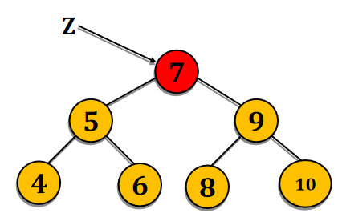
BST Deletion Pseudo code
void delete(node *root, key)
{
IF (root == NULL) THEN
exit
END IF
IF (root->data>key) THEN
delete(root->left, key)
ELSE IF (root->data<key) THEN
delete(root->right, key)
ELSE
deletenode(root)
ENDIF
}
NOT sufficient algorithm
void deleteNode(node *root)
{
IF (root->left == NULL AND root->right == NULL) //Case - 1
free(root) [free is the C function to release the memory allotted to the node]
exit
ENDIF
IF (root->left != NULL) THEN //Case – 4 and Case - 2
struct node *temp=root->left;
WHILE(temp->right!=NULL)
temp=temp->right;
ENDWHILE
root->data=temp->data;
free(temp)
ELSE //Case 3
struct node *temp = root->right;
WHILE(temp->left != NULL)
temp=temp->left;
ENDWHILE
root->data = temp->data;
free(temp);
ENDIF
}

Slide 56
Balanced Binary Tree
The disadvantage of a binary search tree is that its height can be as large as N-1 where N is the number of nodes. This means that the time needed to perform insertion and deletion and many other operations can be O(N) in the worst case.
We want a tree with small height and this can be attained if both subtrees of each node have roughly the same height. So goal is to keep the height of a binary search tree O(log N). Such trees are called balanced binary trees
1
2
3
4
4
5
2
6
6
1
3
5
7
7

Slide 57
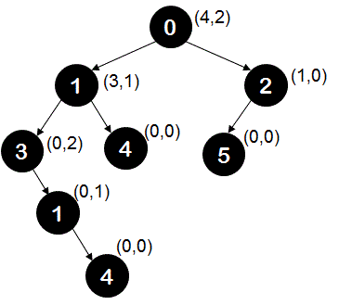
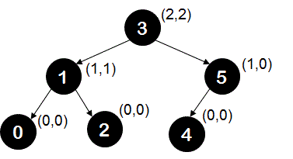
How to check a Binary Tree is balanced or not?
A binary tree is called a balanced binary tree if it satisfies following conditions -
If at any given node, absolute difference of height of left sub-tree and height of right sub-tree (called as balance factor) is not greater than 1 (i.e. should be -1 or 1 or 0)
Balanced
Unbalanced

Slide 58
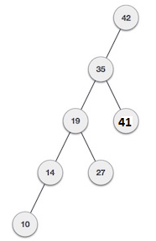
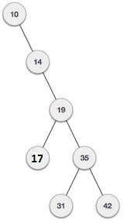
AVL Tree
What if the input to binary search tree comes in sorted (ascending or descending) manner? It will then look like this −
It is observed that BST's worst-case performance closes to linear search algorithms, that is Ο(n). In real time data we cannot predict data pattern and their frequencies. So a need arises to balance out existing BST. Named after their inventor Adelson, Velski & Landis, AVL trees are height balancing binary search tree. AVL tree checks the height of left and right sub-trees and assures that the difference is not more than 1. This difference is called Balance Factor. Balance Factor = height(left-subtree) − height(right-subtree)

Slide 59
AVL Rotation Technique
If the difference in the height of left and right sub-trees is more than 1, the tree is balanced using rotation techniques.
To make itself balanced, an AVL tree may perform four kinds of rotations −
Left rotation
Right rotation
Left-Right rotation
Right-Left rotation
First two rotations are single rotations and next two rotations are double rotations.

Slide 60
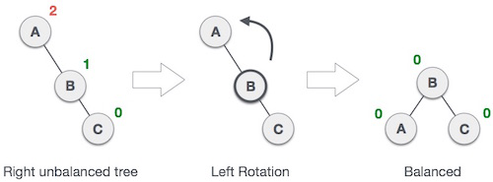
AVL Tree Left Rotation
If a tree become unbalanced, when a node is inserted into the right subtree of right subtree (RR), then we perform single left rotation −
In the above example, node A has become unbalanced as a node is inserted in right subtree of A's right subtree. We perform left rotation by making A left-subtree of B.

Slide 61
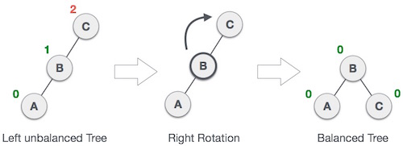
AVL Tree Right Rotation
AVL tree may become unbalanced if a node is inserted in the left subtree of left subtree(LL). The tree then needs a right rotation.
As depicted, the unbalanced node becomes right child of its left child by performing a right rotation.

Slide 62
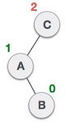
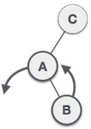
AVL Tree Left-Right Rotation
Double rotations are slightly complex version of already explained versions of rotations. A left-right rotation is combination of left rotation followed by right rotation.
State | Action
 | A node has been inserted into right subtree of left subtree(LR). This makes C an unbalanced node. These scenarios cause AVL tree to perform left-right rotation.
 | We first perform left rotation on left subtree of C. This makes A, left subtree of B.

Slide 63
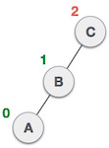
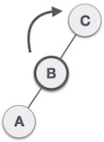
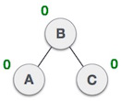
AVL Tree Left-Right Rotation cont…
State | Action
 | Node C is still unbalanced but now, it is because of left-subtree of left-subtree.
 | We shall now right-rotate the tree making B new root node of this subtree. C now becomes right subtree of its own left subtree.
 | The tree is now balanced.

Slide 64
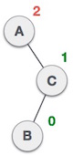
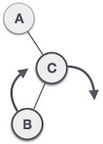
AVL Tree Right-Left Rotation
A right-left rotation is combination of right rotation followed by left rotation.
State | Action
 | A node has been inserted into left subtree of right subtree(RL). This makes A an unbalanced node, with balance factor 2.
 | First, we perform right rotation along C node, making C the right subtree of its own left subtree B. Now, B becomes right subtree of A.

Slide 65


AVL Tree Left-Right Rotation cont…
State | Action
 | Node A is still unbalanced because of right subtree of its right subtree and requires a left rotation.
 | A left rotation is performed by making B the new root node of the subtree. A becomes left subtree of its right subtree B.
 | The tree is now balanced.

Slide 66

Left Rotation

Slide 67

Right Rotation

Slide 68

Left-Right Rotation

Slide 69

Right-Left Rotation

Slide 70
AVL Tree Insertion and Deletion
Insertion
Deletion
After inserting a node, check each of the node's ancestors for consistency with the AVL rules.
For each node checked, if the balance factor remains 1, 0, or -1 then no rotations are necessary. Otherwise, it's unbalanced.
After each insertion, at most two tree rotations are needed to restore the entire tree.
If a node is a leaf, remove it.
If the node is not a leaf, replace it with either the largest in its left subtree (i.e. the rightmost) or the smallest in its right subtree (i.e. the leftmost), and remove that node.
After deletion, retrace the path from parent of the replacement to the root, adjusting the balance factors as needed.

Slide 71





AVL Tree Insertion Example

Slide 72





AVL Tree Deletion Example
Imbalance at 3
Perform Rotation with 2
Imbalance at 5
Perform Rotation with 8

Slide 73
21, 26, 30,9, 4, 14, 28, 18,15, 10, 2, 3, 7

Slide 74

Assignments
A binary tree has 9 nodes. The inorder and preorder traversal of T yields the following sequence of node:
Inorder: E, A, C, K, F, H, D,B,G and Preorder: F, A, E, K, C, D, H, G, B
Draw the tree T
Suppose T is a binary tree. Write a recursive & non-recursive algorithm to find the number of leaf nodes, number of nodes and depth in T. Depth of T is 1 more than the maximum depths of the depths of the left and right subtrees of T.
Suppose T is a binary tree. Write a recursive & non-recursive algorithm to find the height of T.
Insert the following keys in the order to form the binary search tree
J, R, D, G, T, E, M, H, P, A, F, Q
Insert the following keys in the order to form the binary search tree
50, 33, 44, 22, 77, 35, 60, 40
Suppose a binary tree T is in memory. Write the pseudo code to delete all terminals or leaf nodes in T

Slide 75
Assignments cont…
Write a C function to copy the binary tree T to T’
Suppose ROOTA points to a binary tree T1. Write the pseudo code which makes a copy T2 of the tree T1 using ROOTB as pointer
Write algorithm to insert and delete the nodes in B tree.
Write a program to check whether the binary tree is a binary search tree
Write the non-recursive function for inorder traversal, preorder traversal, and postorder traversal of a binary tree.
Write a function to display all the paths from root to leaf nodes in a binary tree.
Write a programme to insert a node into BST both in recursive and non-recursive manner.
Write a programme to display the nodes of a tree in level wise(first we need to display 0th level node, then 1th level nodes and so on).
Write a program to check whether a binary tree is an AVL tree.

Slide 76


Slide 77


Home Work
Find out the inorder, preorder and postorder traversal of the following tree.
Draw the internal memory representation using sequential and linked representation
The inorder and postorder traversals of a binary tree T yield the following sequence of nodes: Inorder : ABCDEFGHI and Postorder: ACEDBHIGF. Find out its Pre-order traversal sequence of the binary tree drawn.
Design a linked data structure to represent the node of an m-way search tree. Write functions SEARCH_MWAY, INSERT_MWAY, DELETE_MWAY to perform search, insert and delete operations on an m-way search tree.
Implement the function DELETE_AVL which delete a given element ITEM from the AVL Search tree T.

Slide 78
Home Work cont…
Draw a complete binary tree with exactly six nodes. Put a different value in each node. Then draw an array with six components and show where each of the six node values would be placed in the array (using the usual array representation of a complete binary tree).
Draw a binary taxonomy tree that can be used for these four animals: Rabbit, Horse, Whale, Snake. A binary taxonomy tree is also called as binary decision tree that allows to going down the tree with simple test.
Are you a mammal?
Yes
No
Are you bigger than a cat
Do you live underwater?
Yes
No
Yes
No
Kangaroo
Mouse
Trout
Robin

Slide 79
Home Work cont…
Draw the binary tree for expression: A *B – (C + D) * (P/Q)
For the following sequence, draw a B-tree of order 3 by inserting the data
91, 24, 6, 7, 11, 8, 21, 4, 5, 16, 19, 20, 76
How many different trees are possible with n nodes?
Draw a full binary tree with at least 6 nodes.
Suppose that a binary search tree contains the number 42 at a node with two children. Write two or three clear sentences to describe the process required to delete the 42 from the tree.
Suppose that we want to create a binary search tree where each node contains information of some data type. What additional factor is required for the data type?
The maximum number of nodes on level i of a binary tree is ?
The maximum number of nodes in a binary tree of depth d is ?
Write a C function swapTree that takes a binary tree root node and swaps the left and right children of every node.

Slide 80
Home Work cont…
Write a function that traverses a threaded binary tree in postorder. What are the time and space requirement of your method?
Write a function that traverses a threaded binary tree in preorder. What are the time and space requirement of your method?
Write pseudo code to delete the node with key k from a binary search tree.
Assume that a binary search tree is represented as a threaded binary search tree. Write functions to search, insert and delete
Write an algorithm to construct the binary tree with given preorder and inorder.
Write the pseudo code to construct the binary tree with given postorder and inorder.
Prove that every binary tree is uniquely by its preorder and inorder sequences.
Please provide constructive suggestions to this course in terms of lectures, home works, or any other aspects

Slide 81

Supplementary Reading
http://www.geeksforgeeks.org/binary-tree-data-structure/
http://www.geeksforgeeks.org/binary-search-tree-data-structure/
https://www.tutorialspoint.com/data_structures_algorithms/tree_data_structure.htm
http://btechsmartclass.com/DS/U3_T1.html
http://btechsmartclass.com/DS/U3_T3.html
https://www.hackerrank.com/domains/data-structures/trees
https://www.youtube.com/watch?v=qH6yxkw0u78
http://nptel.ac.in/courses/106102064/6

Slide 82
FAQ
Describe Trees with an example.
Tree is a structure that is similar to linked list. A tree will have two nodes that point to the left part of the tree and the right part of the tree. These two nodes must be of the similar type.
The following code snippet describes the declaration of trees. The advantage of trees is that the data is placed in nodes in sorted order.
struct TreeNode
{
int item; // The data in this node.
TreeNode *left; // Pointer to the left subtree.
TreeNode *right; // Pointer to the right subtree.
}
What is binary tree?
A binary tree is a tree structure, in which each node has only two child nodes. The first node is known as root node. The parent has two nodes namely left child and right child.
Uses of binary tree:
To create sorting routine.
Persisting data items for the purpose of fast lookup later.
For inserting a new item faster

Slide 83
FAQ cont…
What is a B tree?
A B-tree of order m (the maximum number of children for each node) is a tree which satisfies the following properties :
Every node has <= m children.
Every node (except root and leaves) has >= m/2 children.
The root has at least 2 children.
All leaves appear in the same level, and carry no information.
A non-leaf node with k children contains k – 1 keys
What are threaded binary trees?
In a threaded binary tree, if a node 'A' has a right child 'B' then B's left pointer must be either a child, or a thread back to A.
In the case of a left child, that left child must also have a left child or a thread back to A, and so we can follow B's left children until we find a thread, pointing back to A.
This data structure is useful when stack memory is less and using this tree the treversal around the tree becomes faster.

Slide 84
FAQ
What are Infix, prefix, Postfix notations?
Infix notation: X + Y – Operators are written in-between their operands. This is the usual way we write expressions. An expression such as A * ( B + C ) / D
Postfix notation (also known as “Reverse Polish notation”): X Y + Operators are written after their operands. The infix expression given above is equivalent to A B C + * D/
Prefix notation (also known as “Polish notation”): + X Y Operators are written before their operands. The expressions given above are equivalent to / * A + B C D
What is a B+ tree?
It is a dynamic, multilevel index, with maximum and minimum bounds on the number of keys in each index segment. all records are stored at the lowest level of the tree; only keys are stored in interior blocks.

